Slide 1

Web Server
Huang Hao, Zhou Yitong, Meng Yu, Chen Zijie, Wen Tianshu
2024.11.15

Slide 2
CONTENTS
Introduction of web server
01 Introduction
Divide of tasks
02 client
CONTENTS
03 server
04 Test
Version control
05 Conclusion
Summarize functional implementations

Slide 3
01
PART
Introduction

Slide 4






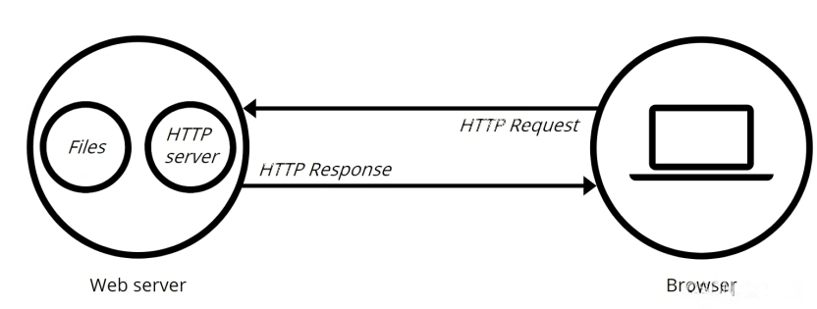

Prepare
client
server
test
conclusion
Web Server working flow
Client
Steps
①Connect to each other
②Communicate with each other

Slide 5
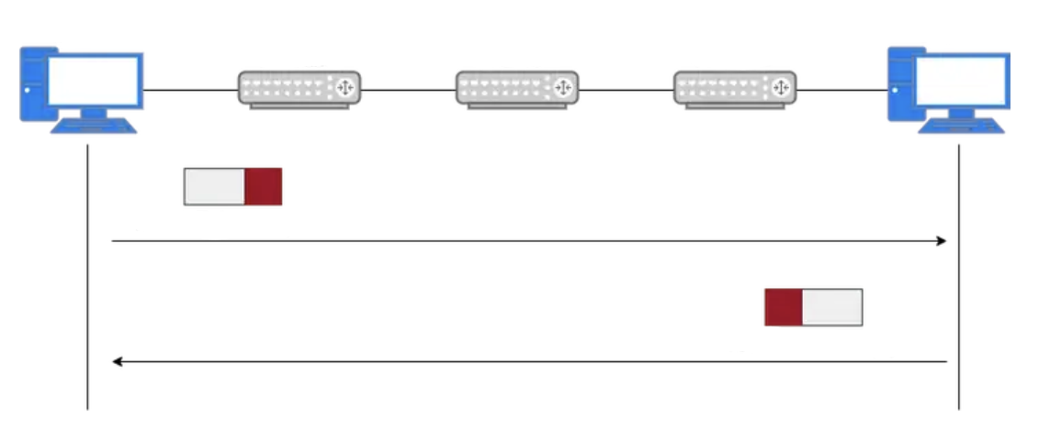
Prepare
client
server
test
conclusion
Web Server VS Ping
Web Server
Are they similar？
Host A
Router A
Router B
Router C
Host B
Ping
ICMP Echo Request
ICMP Echo Reply

Slide 6
Prepare
client
server
test
conclusion
Web Server VS Ping
Name
Web Server
Ping
Protocol
HTTP
ICMP
Working Level
Application
Website
Function
Accept the message and return the web content of the response
Check if the target host is reachable
Contact：
If the ping test results show that the destination server is unreachable, the website cannot be accessed through the browser, even if the webserver is functioning normally.

Slide 7
Prepare
client
server
test
conclusion
Division of tasks
Huang Hao
Getting through the code framework
UI design
safety config design
Windows testing
Wen Tianshu
server design
log safety
rate control
Zhou Yitong
Beautify output
Task framework design
test_client design
Chen Zijie(presentor)
concurrent control
muti-file construction
test_client design
Meng Yu
client design
Functional testing
test_client design

Slide 8
02
PART
client

Slide 9


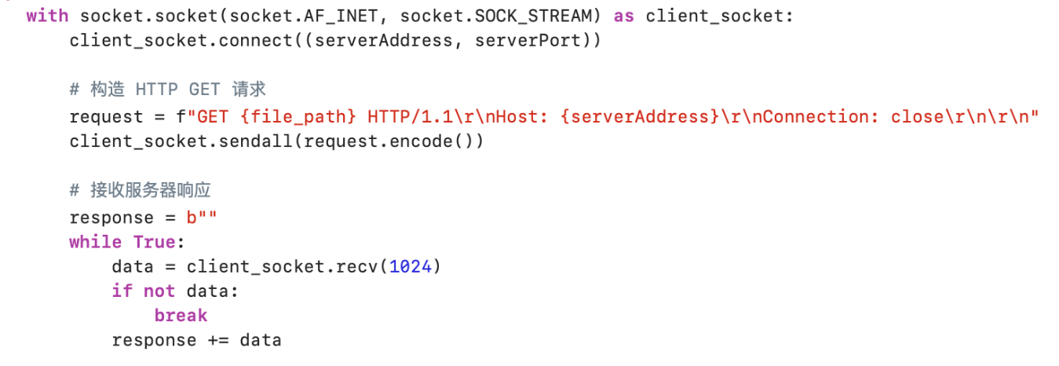
Prepare
client
server
test
conclusion
send request
Establish a TCP connection:
Create a TCP socket client socket, using AF_INET for the IPv4 address and SOCK_STREAM for the TCP connection. Use the with statement to ensure that the client socket is automatically closed after use.
Connect to the specified server address and port.
Construct and send the request: Construct a simple HTTP GET request with the file path specified by the file_path parameter. The request contains the HTTP/1.1 protocol version, the Host address host, and the Connection: close field (indicating that the connection is closed when the request is complete). The request is then sent to the server via the socket.
Receive data: Initializes an empty byte response to store the data returned by the server. Enter the while loop, receiving up to 1024 bytes of data at a time from the server

Slide 10
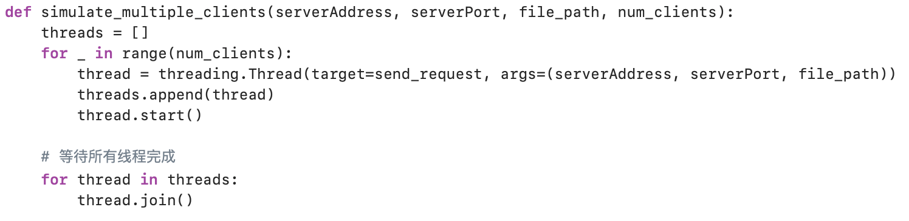
Prepare
client
server
test
conclusion
Simulate multiple clients
Function Description: Simulate multiple clients to send HTTP requests to a specified server. It implements concurrent requests from multiple clients through multiple threads
Create a loop that iterates num_clients a few times. In each iteration:
1. Create a thread whose object function is send_request and pass the corresponding parameters.
2. Add the thread to the threads list.
3. Start the thread and immediately start executing the send_request function, which sends a request to the server.

Slide 11
03
PART
server

Slide 12





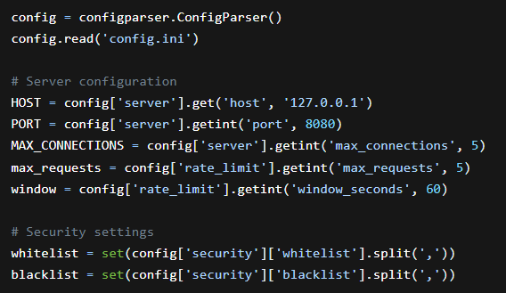
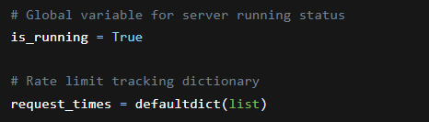
Prepare
client
server
test
conclusion
Configuration Reading and Global Variables
Configuration File Reading
1. Create a configparser.ConfigParser() instance and read the config.ini file.
2. Retrieve server configuration:
Get the HOST from the [server] section, defaulting to 127.0.0.1.
Get the PORT from the [server] section, defaulting to 8080.
Get the MAX_CONNECTIONS from the [server] section, defaulting to 5.
3. Read rate - limiting configuration:
Get the max_requests from the [rate_limit] section, defaulting to 5.
Get the window from the [rate_limit] section, defaulting to 60 seconds.
4. Load security settings:
Create the whitelist by splitting the [security] section's whitelist parameter.
Create the blacklist by splitting the [security] section's blacklist parameter.
Global Variable Explanation
1. The key global variable is_running is used to control the server's running status.
2. The request_times dictionary is used to track client request times for rate limiting.

Slide 13

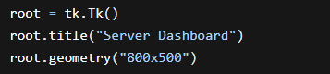
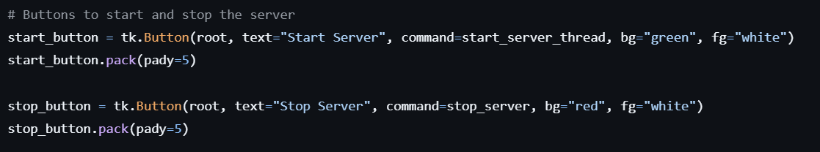
Prepare
client
server
test
conclusion
Graphical User Interface (GUI)
GUI Initialization
The tkinter library is used to initialize the GUI. It creates the main window (root), sets the window's title and size.
Interface Component Introduction
Log Display Area:
The log_area (a scrolledtext.ScrolledText) is created to display various log information during the server's operation.
The log_message function is used to insert log content with different color tags.
Server Status Label:
The status_label is used to display the current running status of the server in real-time. It changes the text content and color to prompt the user.
Start and Stop Buttons:
The start_button and stop_button are created and bound to corresponding functions (start_server_thread and stop_server) to allow the user to control the server's startup and stop operations.

Slide 14

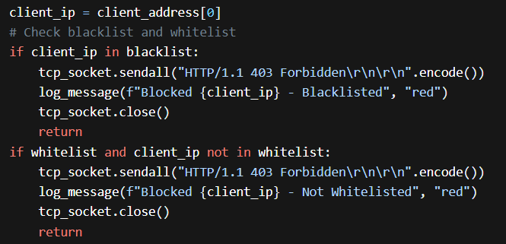
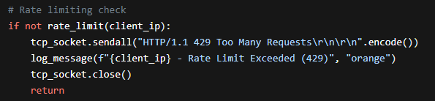
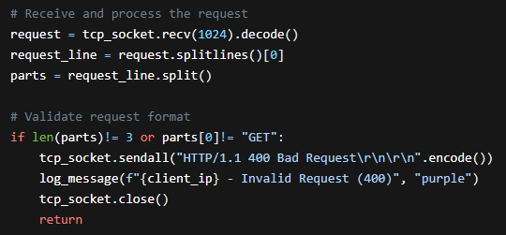
Prepare
client
server
test
conclusion
Core Function - Request Handling (handle_request)
Security Check Part
Blacklist and Whitelist Check: Checks if the client IP is in the blacklist or not in the whitelist. If in the blacklist, it directly returns a 403 Forbidden response and records the log. If the whitelist is enabled and the IP is not in it, the access is also denied.
Rate Limit Check
Checks if the rate limit is exceeded based on the request_times dictionary and the configured window and max_requests. If exceeded, it returns a 429 Too Many Requests response.
Request Format Validation and File Handling Part
Request Format Validation: Checks if the client request is a valid GET method and in the correct format. If not, it returns a 400 Bad Request response.

Slide 15
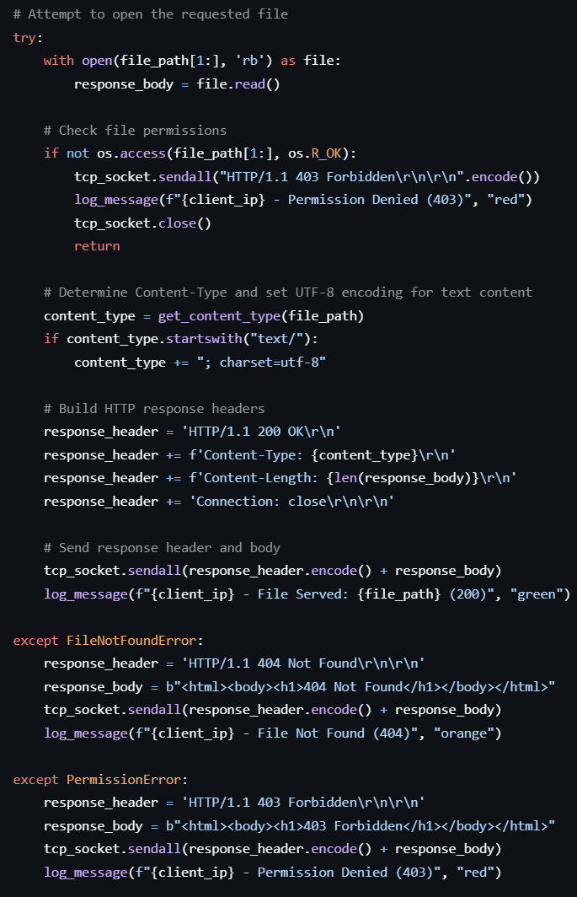
Prepare
client
server
test
conclusion
Core Function - Request Handling (handle_request)
File Reading and Response Building Part
Tries to open the requested file. If the file is not found, it returns a 404 Not Found response. If there is a permission error, it returns a 403 Forbidden response.
After successfully reading the file, it determines the Content-Type (using the get_content_type function), sets the UTF-8 encoding for text content, builds the HTTP response headers and body, and sends the response to the client.

Slide 16
04
PART
Testing

Slide 17





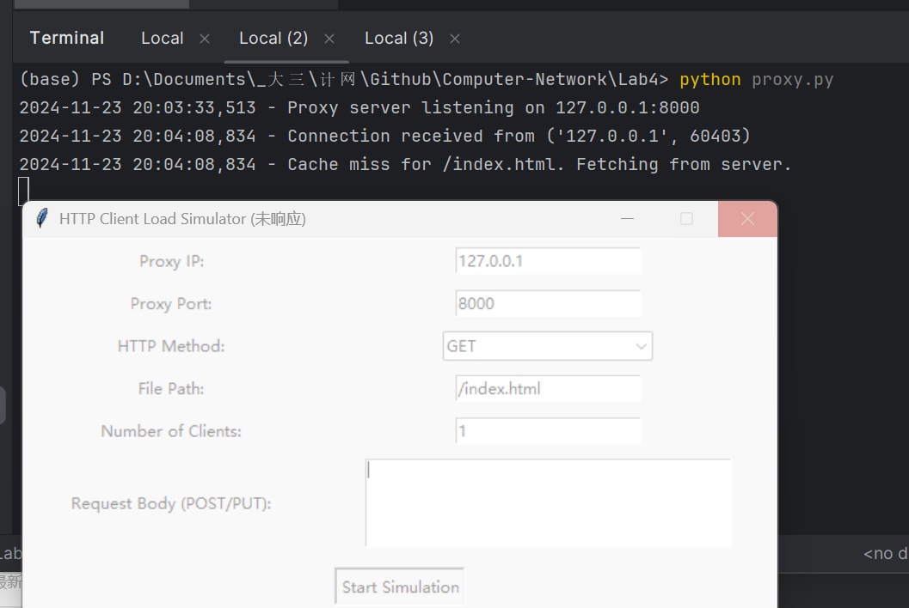
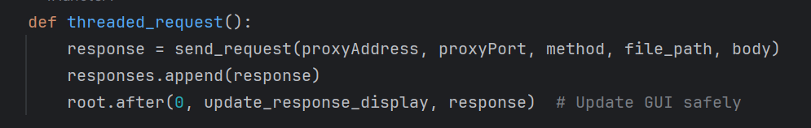
introduction
client
server
test
conclusion
Multiple problems have been solved
1. client.py can’t reply: The main thread is blocked
Possible Solution:
thread.join()
root.after()
Update the response_display asynchronously to ensure that the UI doesn't get stuck with data writes

Slide 18
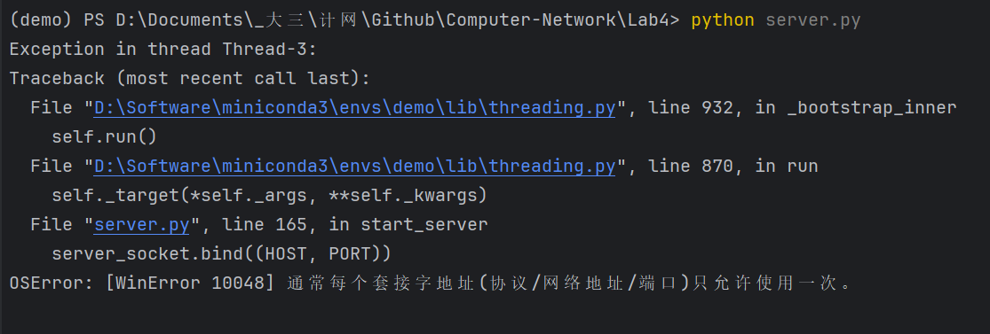
introduction
client
server
test
conclusion
Multiple problems have been solved
2. Socket parameter error:
Possible Solution:
Change the web server or proxy port

Slide 19
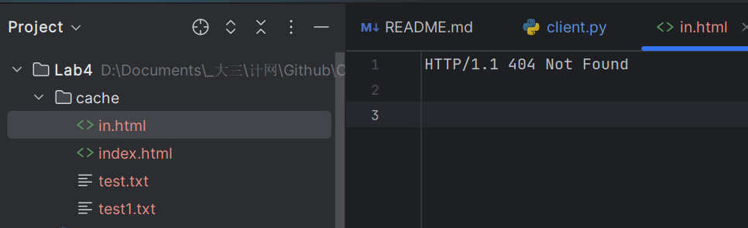
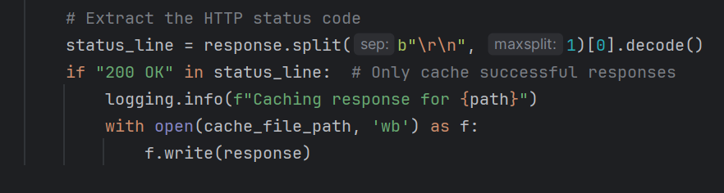
introduction
client
server
test
conclusion
Multiple problems have been solved
3. Unexpected storage in cache:
Possible Solution:
We only want to store the acessable file.
Add a new condition:

Slide 20
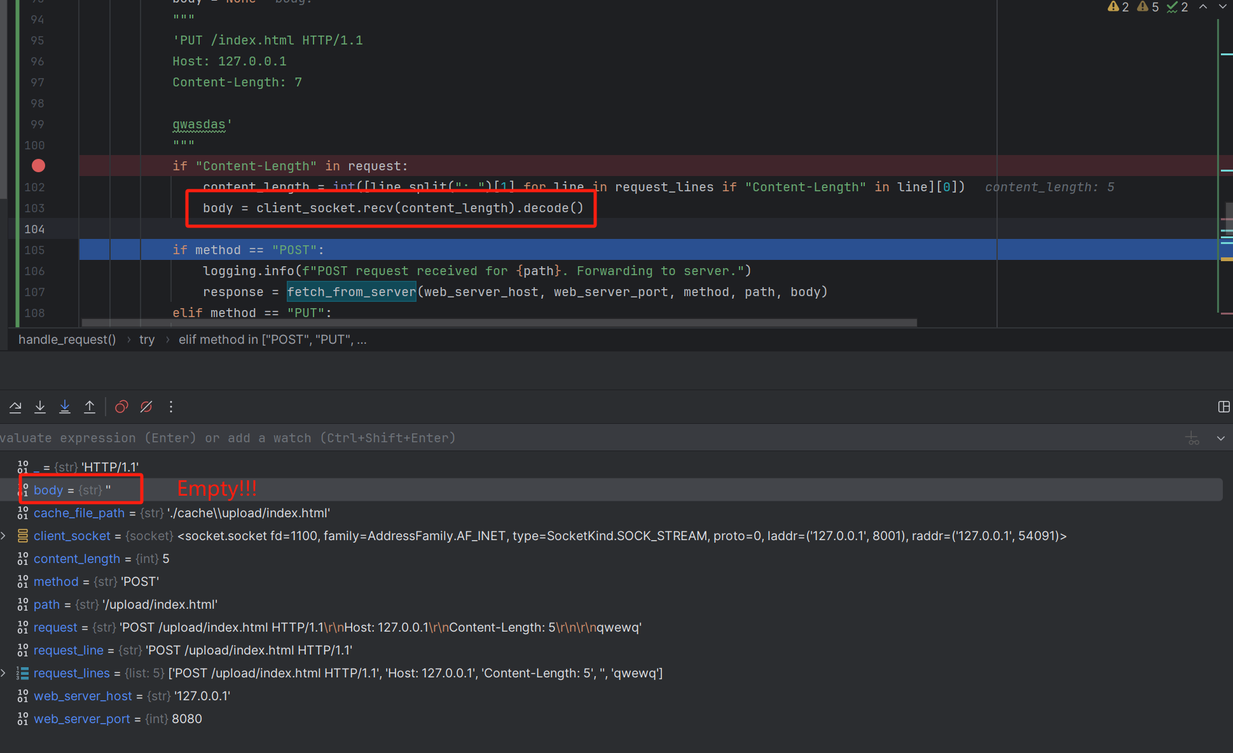
introduction
client
server
test
conclusion
Multiple problems have been solved
4. Post unsccessfully:

Slide 21
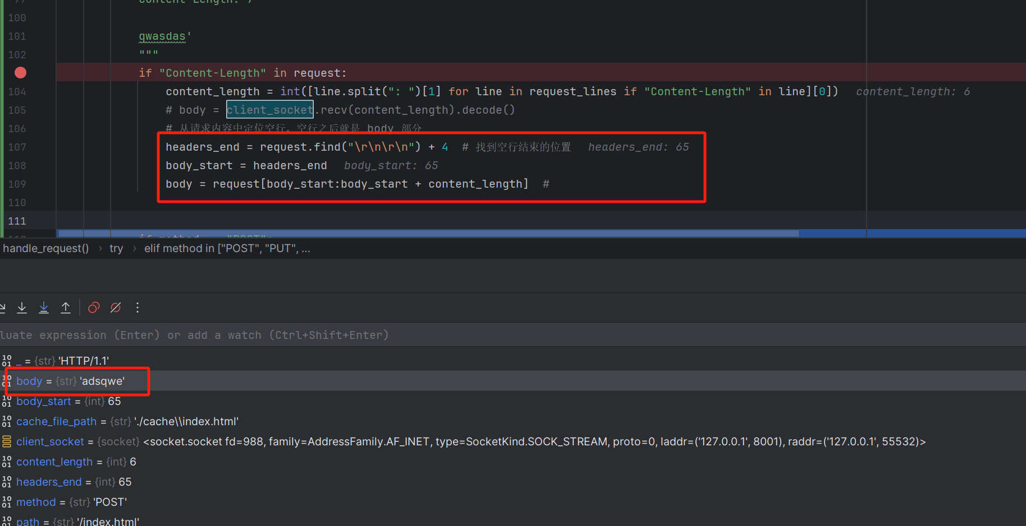
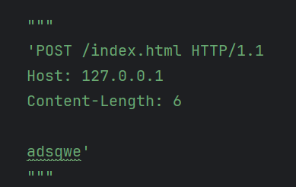
introduction
client
server
test
conclusion
Multiple problems have been solved
4. Post sccessfully:

Slide 22
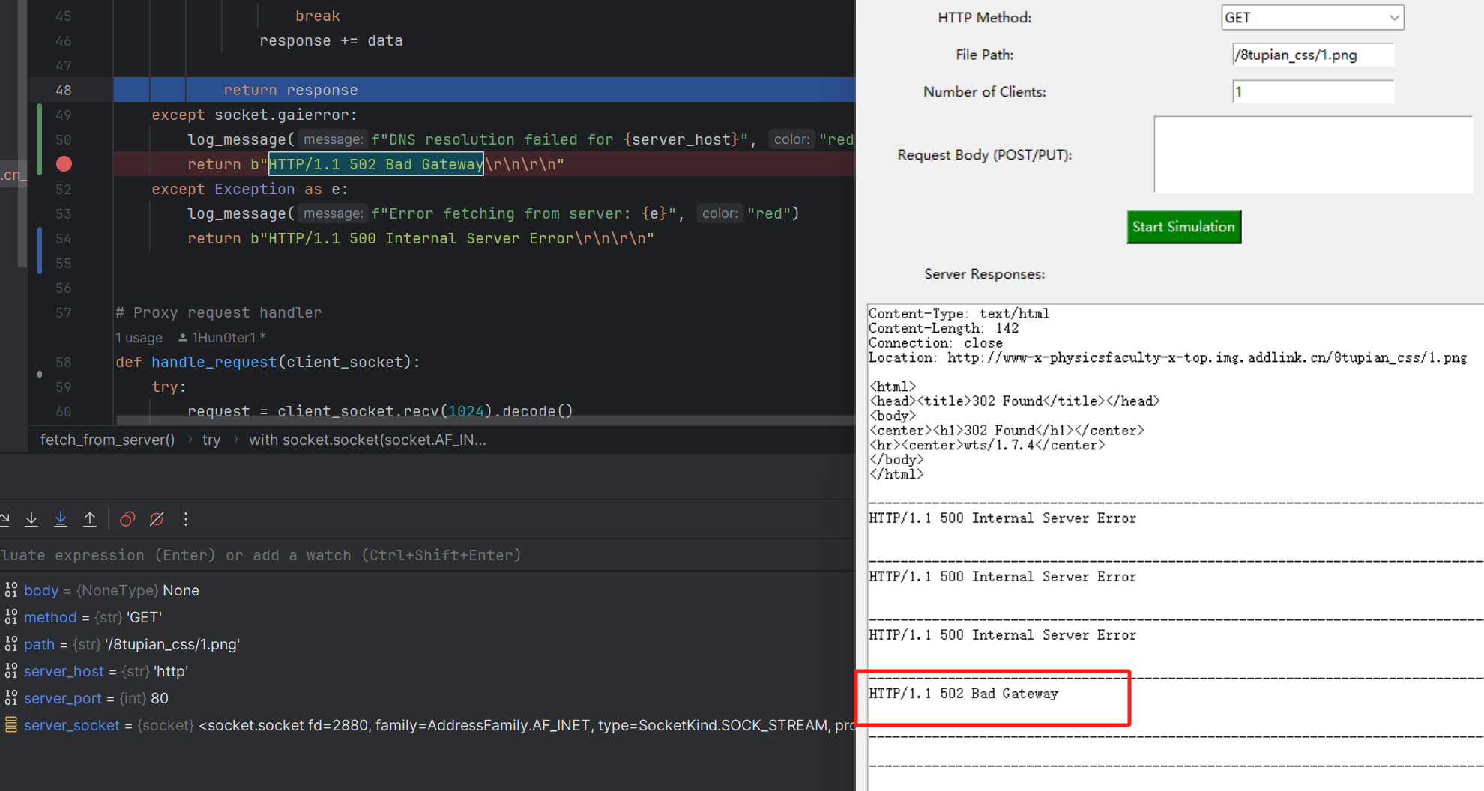
introduction
client
server
test
conclusion
Multiple problems have been solved
5. DNS resolution failed:

Slide 23
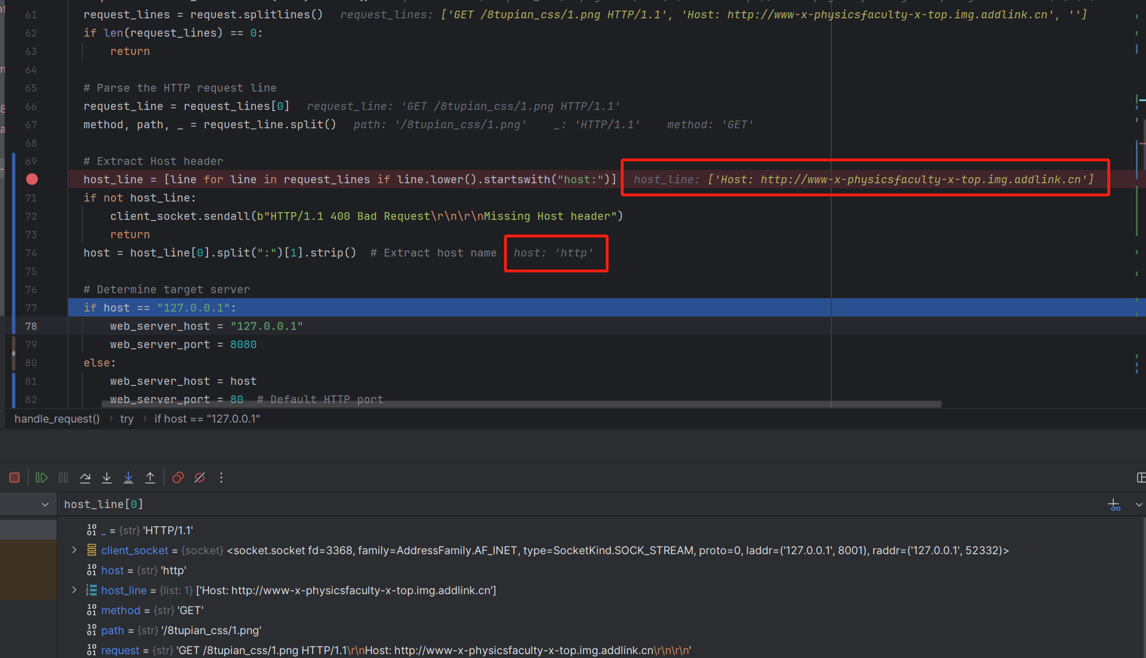
introduction
client
server
test
conclusion
Multiple problems have been solved
5. DNS resolution failed:

Slide 24
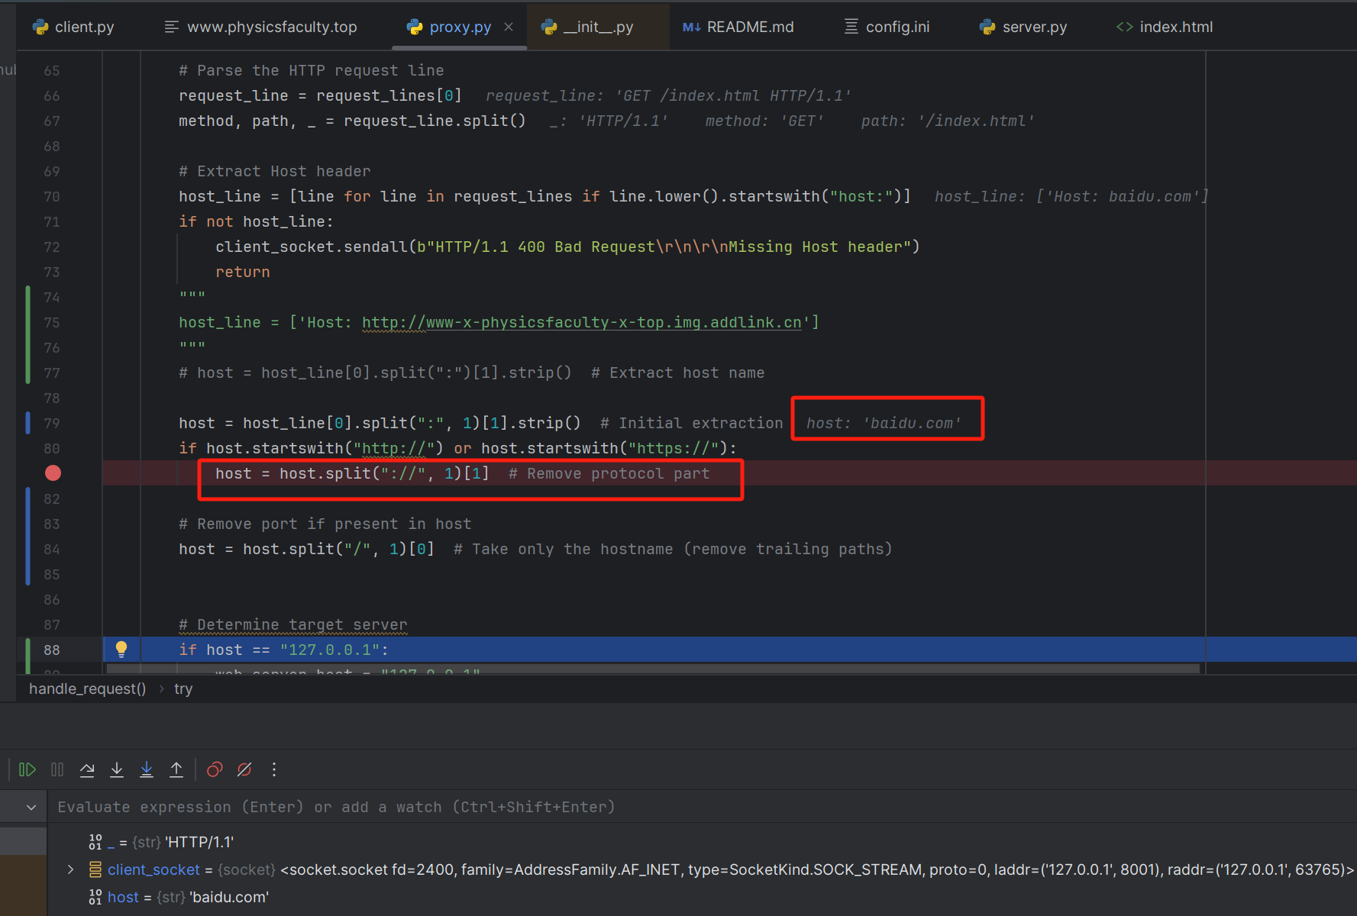
introduction
client
server
test
conclusion
Multiple problems have been solved
5. DNS resolution successfully:

Slide 25
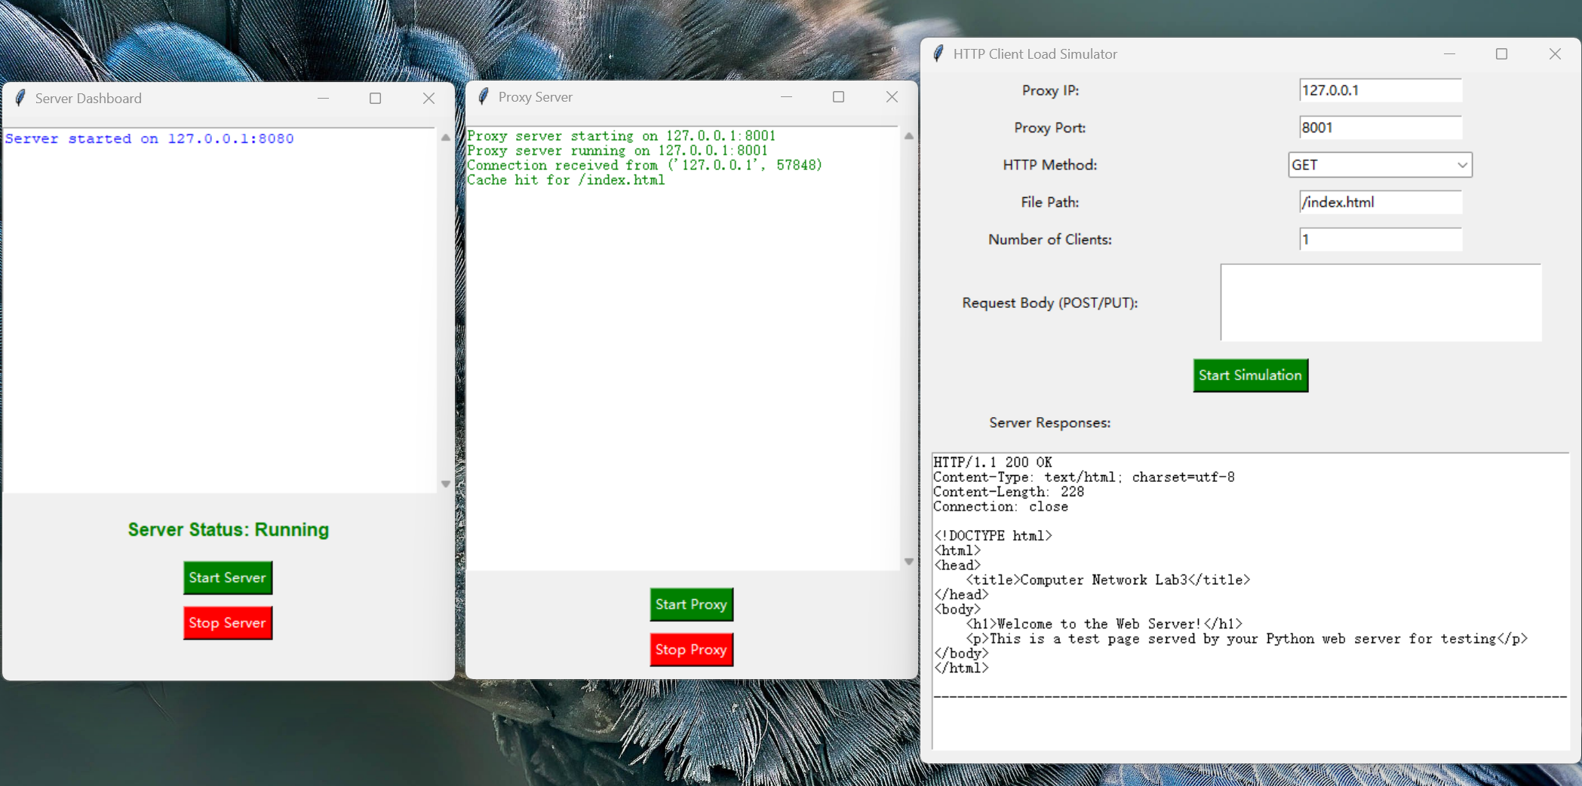
introduction
client
server
test
conclusion
Show the result
get method

Slide 26
05
PART
Conclusion

Slide 27


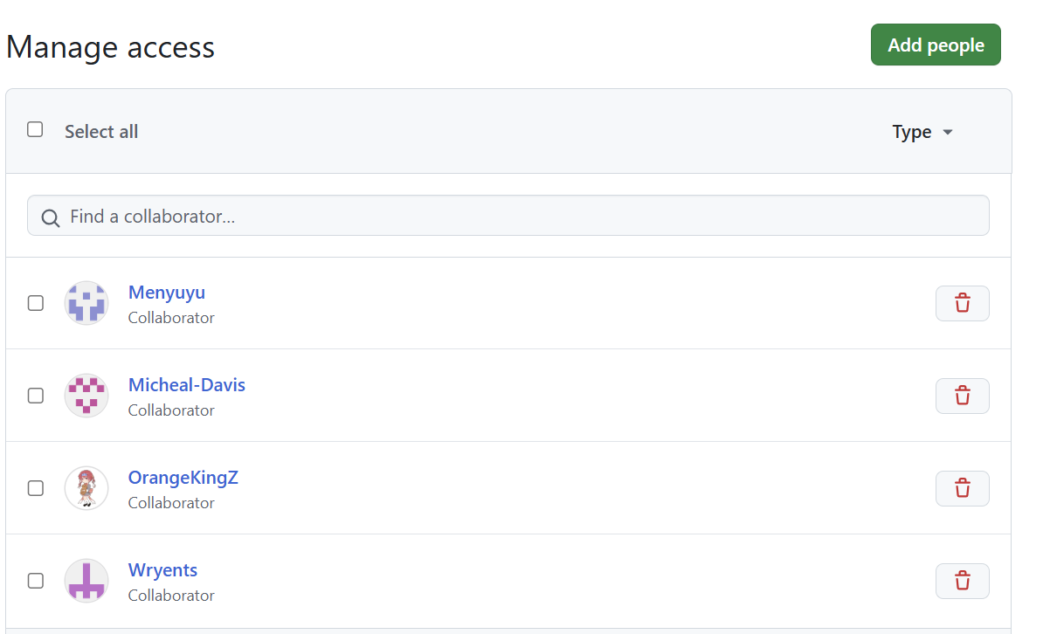
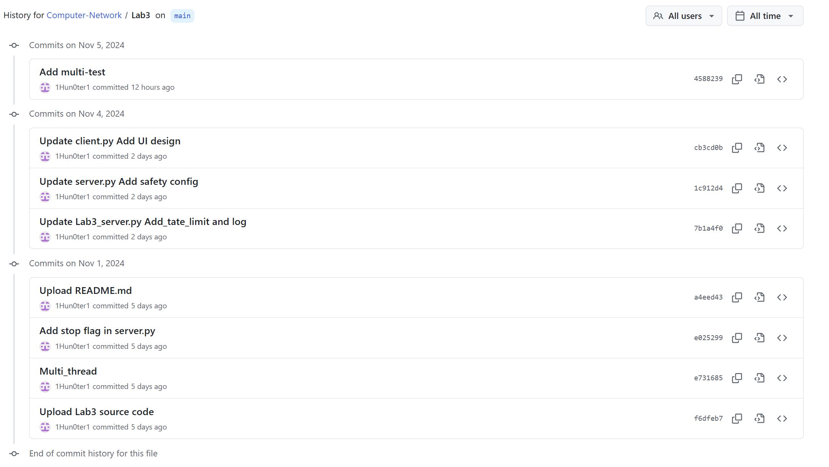
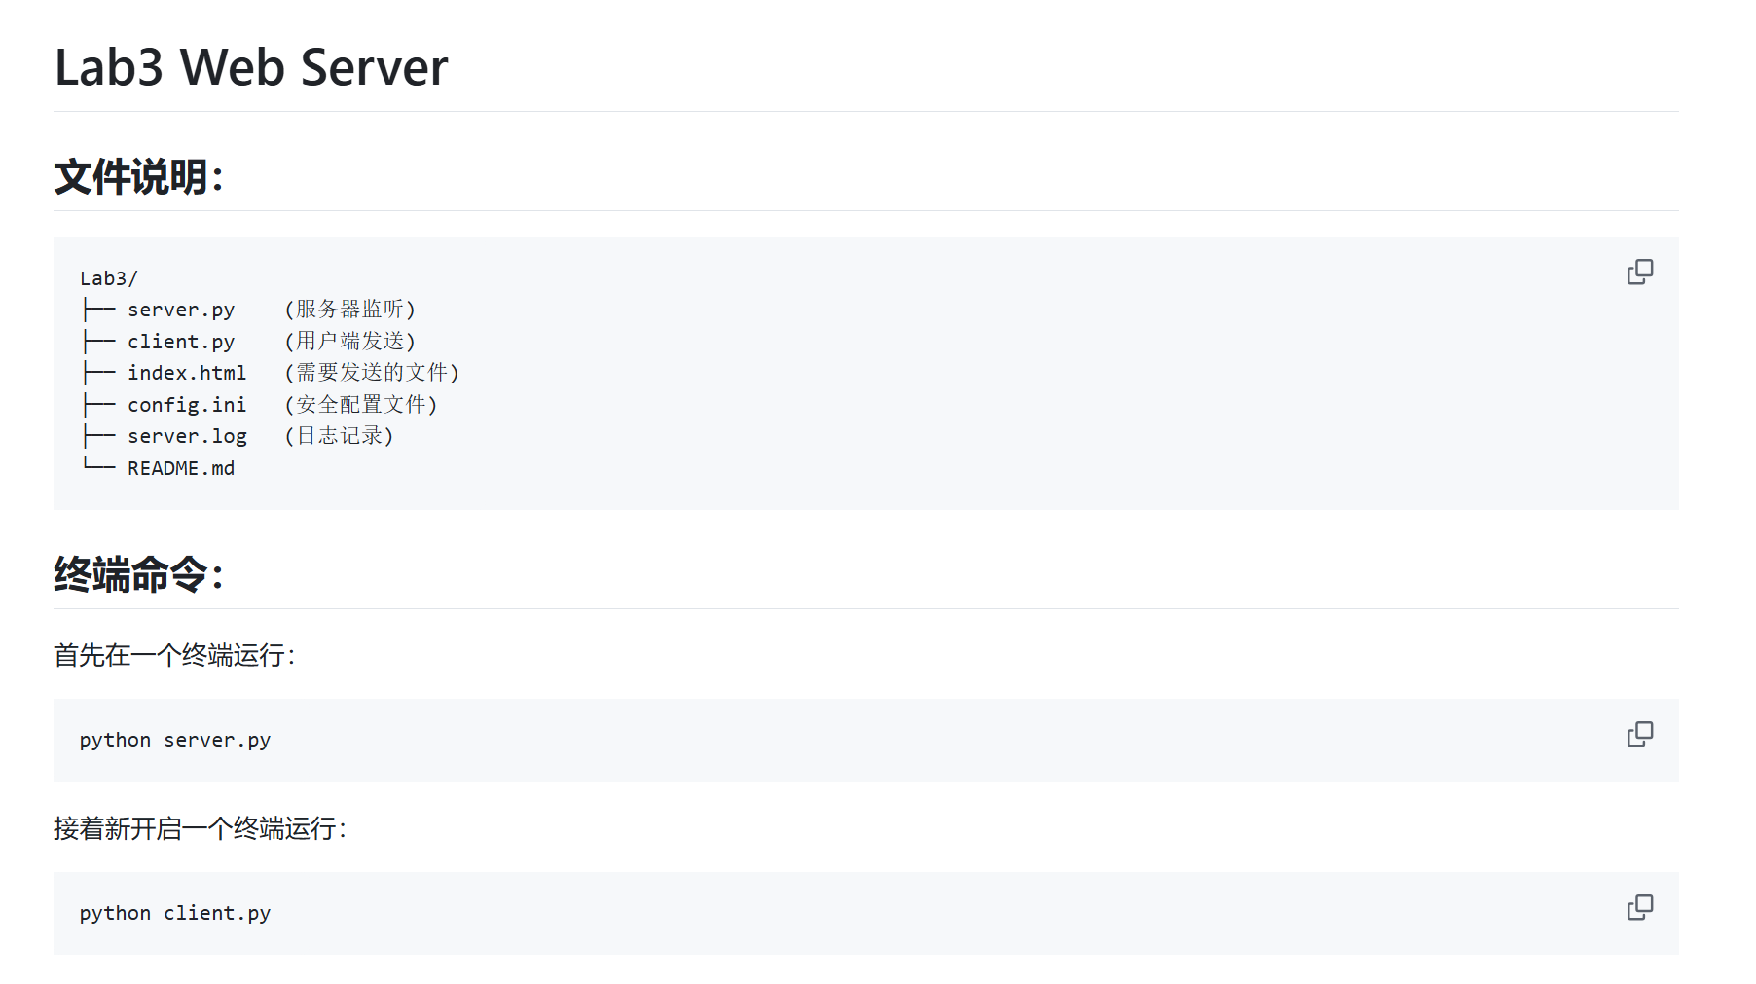
prepare
client
server
test
conclusion
Version control: Using Github
README.md
9 files
config.ini, server.log
8 histories
5 collaborators

Slide 28
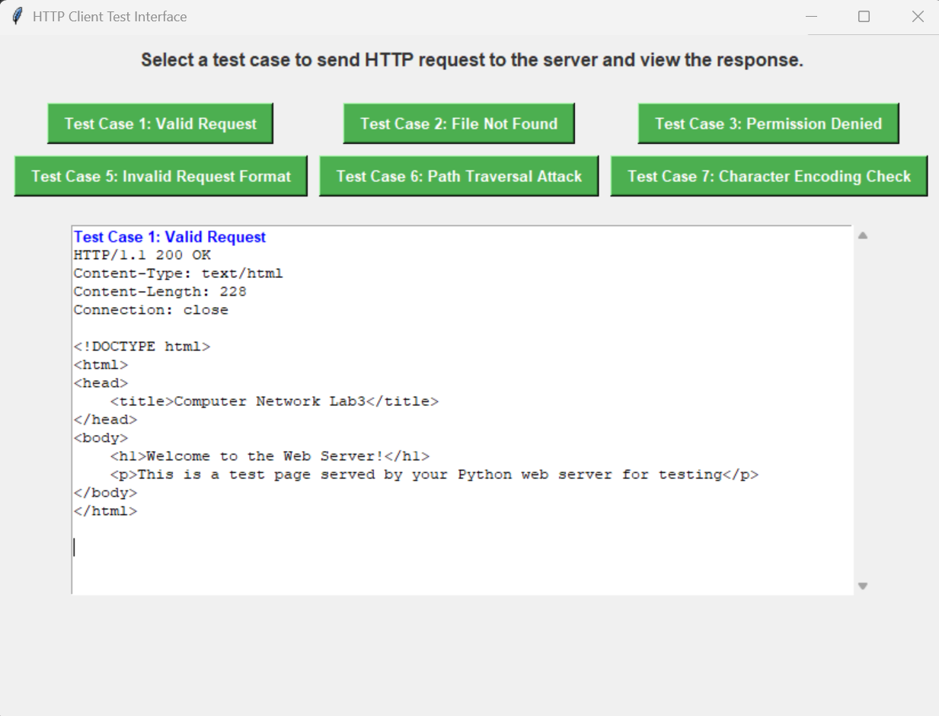
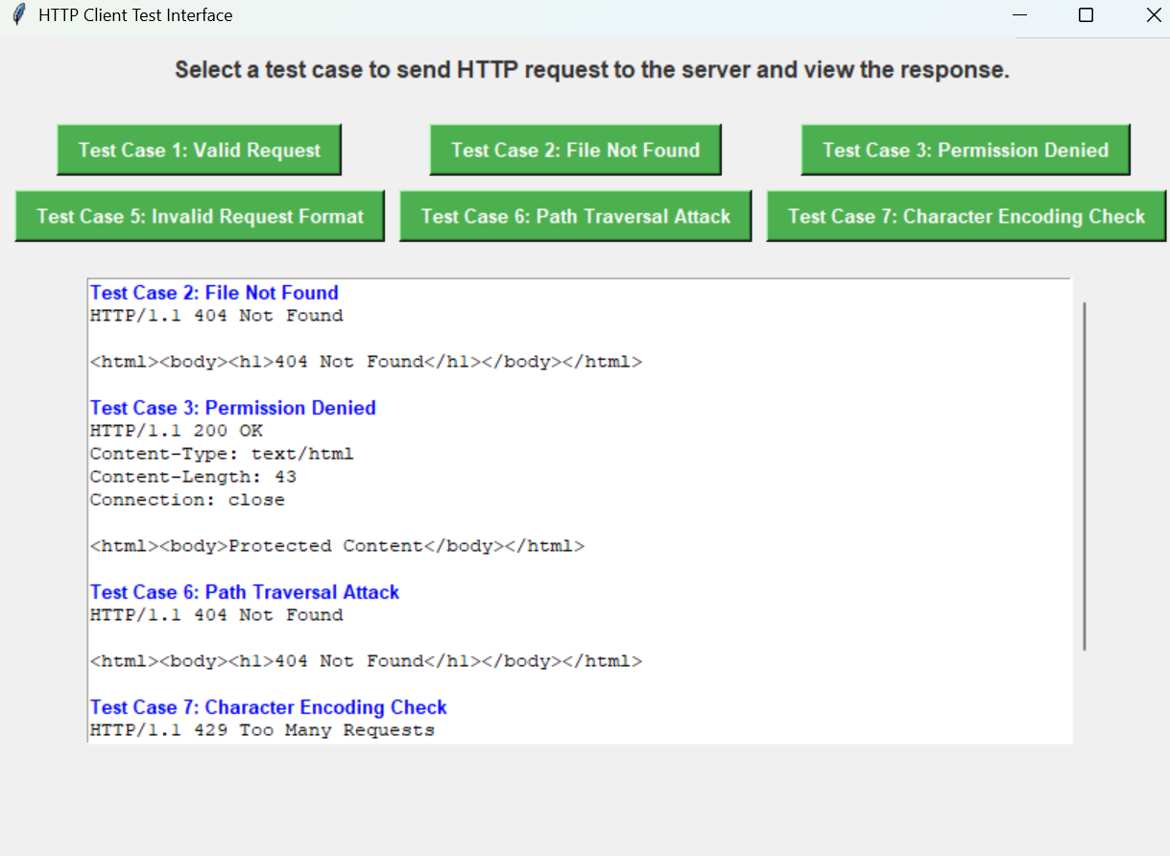
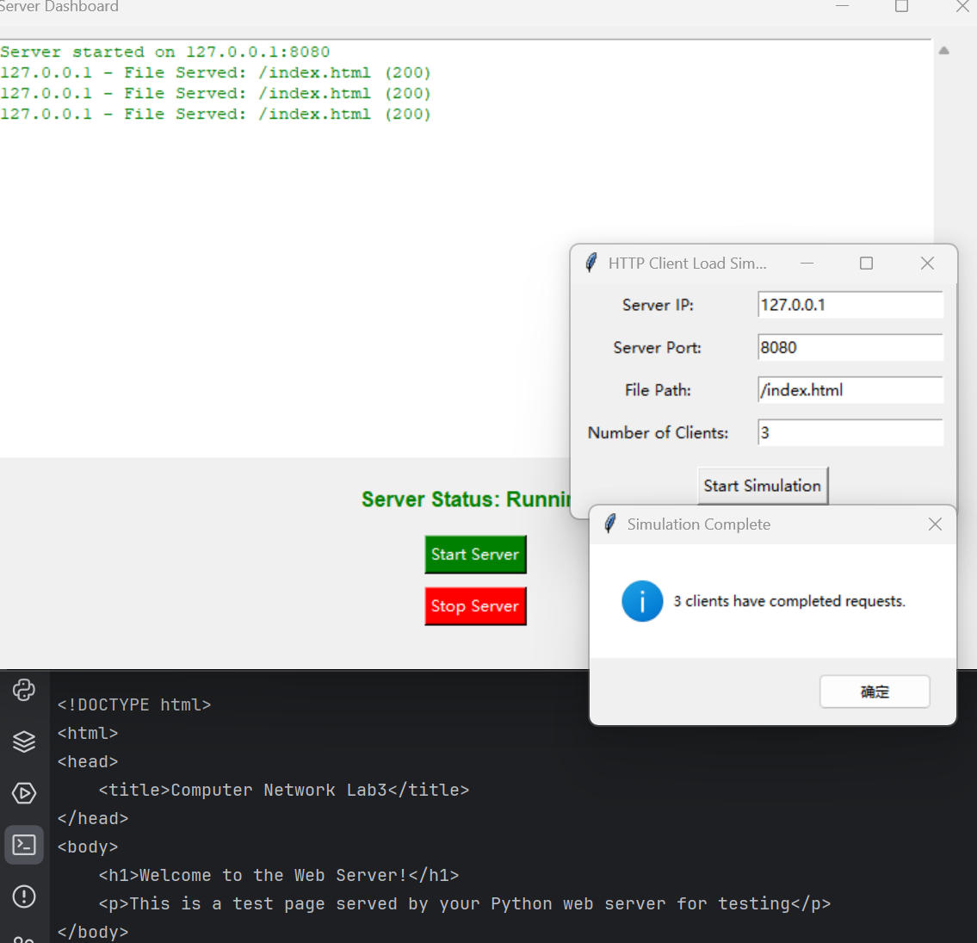
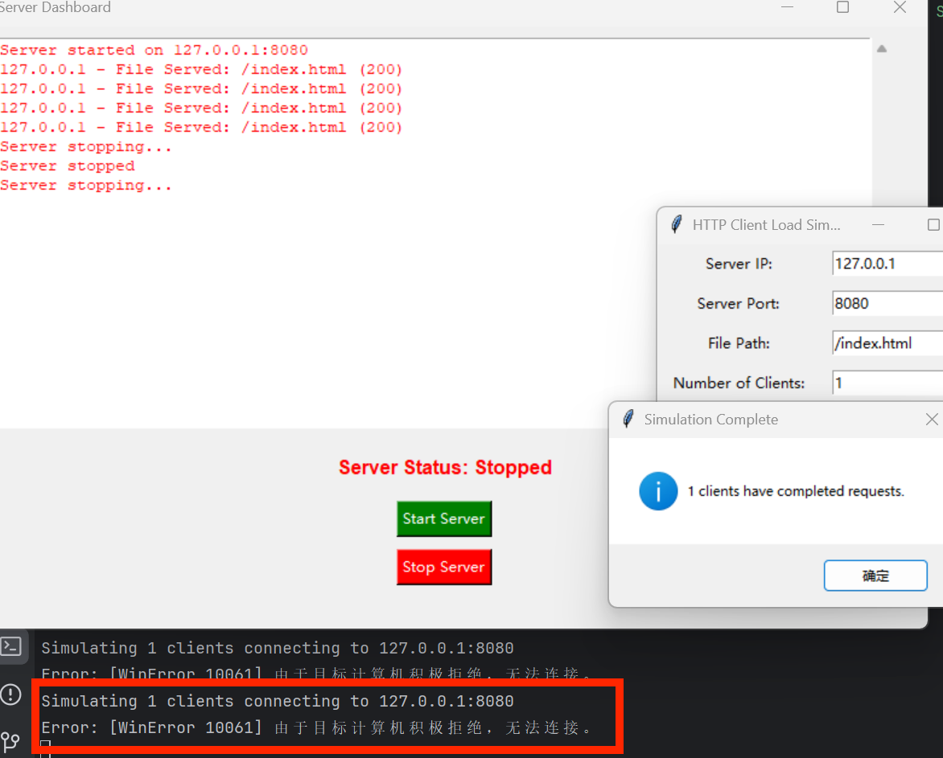
prepare
client
server
test
conclusion
Summary of all functional implementations
Simulation of server & client
Multithreading
rate control
safety config design
UI design
log storage(.log)

Slide 29
Thank you!
Huang Hao, Zhou Yitong, Meng Yu, Chen Zijie, Wen Tianshu
2024.11.15

